Slide 1
PNUTS: Yahoo!’s Hosted Data Serving Platform
Ravi Teja Reddy Kandkatla
Teja Garidepally
Sri Harsha Chennavajjala
Raj Kiran Reddy Munnangi
Vinay Kumar Matoori
Rajeev Reddy
Swarna Kosaraju

Slide 2

Motivation
The foremost requirements for any web application:
Scalability
Architectural scalability, scale linearly
Response Time and Geographic Scope
Data Replicas on multiple continents
High Availability and Fault tolerance
failures, apps will still be able to read data
Relaxed Consistency Guarantees.
Tolerate stale or reordered data

Slide 3

Motivation (Contd..)
Eventual consistency
Transactions:
Alice changes status from “Sleeping” to “Awake”
Alice changes location from “Home” to “Work”
(Alice, Home, Sleeping)
(Alice, Home, Awake)
(Alice, Work, Awake)
Region 1
Awake
Work
Awake
Final state consistent
Work
(Alice, Home, Sleeping)
(Alice, Work, Sleeping)
(Alice, Work, Awake)
Region 2
“Invalid” state visible
Source: http://www.slideshare.net/smilekg1220/pnuts-12502407

Slide 4
PNUTS Overview
Data Model and features :
PNUTS exposes a simple relational model to users, and supports single-table scans with predicates.
scatter-gather operations
Asynchronous notification of clients
Bulk loading.
Fault tolerance :
PNUTS employs redundancy at multiple levels like data, metadata, and serving components.

Slide 5
PNUTS Overview (Contd..)
Pub/Sub Message system
Asynchronous operations are carried out over a topic-based pub/sub system called Yahoo! Message Broker (YMB), which together with PNUTS, is part of Yahoo!’s Sherpa data services platform.
Record-level Mastering
PNUTS have chosen to make all high latency operations asynchronous, and to support record-level mastering.
Hosting
PNUTS is a hosted, centrally-managed database service shared by multiple applications.

Slide 6
PNUTS: Contributions
Asynchronous geographic replication, and use of a guaranteed message delivery service
A consistency model that offers applications transactional features.
Delivery of data management as a hosted service.
A choice of features to include like hashed and ordered table organizations, flexible schemas or exclude limits on ad hoc queries, no referential integrity.

Slide 7
Data and Query Model
PNUTS presents a simplified relational data model to the user where data is organized into tables of records with attributes.
In addition to typical data types, “blob” is a valid data type
Schemas are flexible
Supports selection and projection from a single table
Point access and Range access
Read and write single or small groups of records
“Multiget” operation for retrieving multiple records

Slide 8
Missing features & Future work
PNUTS does not enforce constraints such as referential integrity, although this would be very desirable.
Another missing feature is complex ad hoc queries
Future Work: Improving query functionality; should not jeopardize the response-time and availability currently guaranteed

Slide 9
Consistency Model
To achieve both availability and partition tolerance, it uses a novel notion of consistency called per-record timeline consistency.
All replicas of a record apply all updates to the record in the same order.
However, it is applicable to only a single record, and hence, it is not suitable for transactions involving multiple records.
Record inserted
Update
Update
Update
Update
Update
Update
Update
Delete
Update
v. 1
v. 2
v. 3
v. 4
v. 5
v. 6
v. 7
v. 8
Time
Generation 1
Time
Source:http://www.cse.iitb.ac.in/infolab/Data/Courses/CS632/Talks/pnuts-vldb08.ppt

Slide 10
Consistency Model (Contd..)
One of the replicas is designated as the master, independently for each record, and all updates to that record are forwarded to the master.
The master replica can be adaptively changed depending on the work load.
The replica receiving majority of write requests become master replica for the record.
The sequence number will be carried by each and every record ,that is incremented by every write.

Slide 11
Consistency Model (Contd..)
By using per-record timeline consistency, it supports variety of API calls with varying levels of consistency guarantees, as follows:
Read any.
Read-critical (required-version).
Read-latest.
Write.
Test-and-set-write (required-version).

Slide 12
Consistency Model (Contd..)
Read-any:
Read
Stale version
Stale version
Current version
v. 1
v. 2
v. 3
v. 4
v. 5
v. 6
v. 7
v. 8
Generation 1
Time
Source:http://www.cse.iitb.ac.in/infolab/Data/Courses/CS632/Talks/pnuts-vldb08.ppt

Slide 13
Consistency Model (Contd..)
Read-critical (required version):
Read ≥ v.6
Stale version
Stale version
Current version
v. 1
v. 2
v. 3
v. 4
v. 5
v. 6
v. 7
v. 8
Generation 1
Time
Source:http://www.cse.iitb.ac.in/infolab/Data/Courses/CS632/Talks/pnuts-vldb08.ppt

Slide 14
Consistency Model (Contd..)
Read-latest:
Read up-to-date
Stale version
Stale version
Current version
v. 1
v. 2
v. 3
v. 4
v. 5
v. 6
v. 7
v. 8
Generation 1
Time
Source:http://www.cse.iitb.ac.in/infolab/Data/Courses/CS632/Talks/pnuts-vldb08.ppt

Slide 15
Consistency Model (Contd..)
Write:
Write
Stale version
Stale version
Current version
v. 1
v. 2
v. 3
v. 4
v. 5
v. 6
v. 7
v. 8
Generation 1
Time
Source:http://www.cse.iitb.ac.in/infolab/Data/Courses/CS632/Talks/pnuts-vldb08.ppt

Slide 16
Consistency Model (Contd..)
Test-and-set-write (Required-version):
Write if = v.7
ERROR
Stale version
Stale version
Current version
v. 1
v. 2
v. 3
v. 4
v. 5
v. 6
v. 7
v. 8
Generation 1
Time
Source:http://www.cse.iitb.ac.in/infolab/Data/Courses/CS632/Talks/pnuts-vldb08.ppt

Slide 17
Yahoo! Cloud Data Systems
Yahoo!
Cloud
Hadoop
Large Data Analysis
PNUTS
Structured Record Storage
MobStor
Large Blob Storage
CRUD
Point lookups and short scans
Index organized table and random I/Os
Scan oriented workloads
Focus on Sequential disk I/O
Object retrieval and streaming
Scalable file storage
Source:http://www.brianfrankcooper.net/

Slide 18







Example: social network updates
Brian
Sonja
Jimi
Brandon
Kurt
What are my friends up to?
Sonja:
Brandon:
Source:http://www.brianfrankcooper.net/

Slide 19
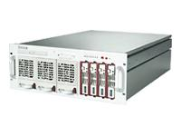
Example: social network updates
6 Jimi <ph..
8 Mary <re..
12 Sonja <ph..
15 Brandon <po..
<photo>
<title>Flower</title>
<url>www.flickr.com</url>
</photo>
16 Mike <ph..
17 Bob <re..
Source:http://www.brianfrankcooper.net/

Slide 20

What is PNUTS?
A 42342 E
A 42342 E
B 42521 W
B 42521 W
C 66354 W
C 66354 W
D 12352 E
D 12352 E
E 75656 C
E 75656 C
F 15677 E
F 15677 E
Indexes and views
CREATE TABLE Parts (
ID VARCHAR,
StockNumber INT,
Status VARCHAR
…
)
Parallel database
Geographic replication
A 42342 E
B 42521 W
C 66354 W
Structured, flexible schema
D 12352 E
E 75656 C
F 15677 E
Hosted, managed infrastructure
Source:http://www.brianfrankcooper.net/

Slide 21
PNUTS-Single Region
Routes client requests to correct storage unit
Caches the maps from the tablet controller
Maintains map from database.table.key to tablet to storage-unit
Stores records
Services get/set/scan requests
Source:http://web.eecs.umich.edu/~michjc/eecs584/notes/lecture18-pnuts.pptx

Slide 22
PNUTS Multi-Region
Source:http://web.eecs.umich.edu/~michjc/eecs584/notes/lecture18-pnuts.pptx

Slide 23
Data Model: Hash
Primary Key | Record
Grape | {"liquid" : "wine"}
Lime | {"color" : "green"}
Apple | {"quote" : "Apple a day keeps the …"}
Strawberry | {"spread" : "jam"}
Orange | {"color" : "orange"}
Avocado | {"spread" : "guacamole"}
Lemon | {"expression" : "expensive crap"}
Tomato | {"classification" : "yes… fruit"}
Banana | {"expression" : "goes bananas"}
Kiwi | {"expression" : "New Zealand"}
0x0000
0x2AF3
Tablet
0x911F
Source:http://www.brianfrankcooper.net/

Slide 24
Data Model: Ordered
Primary Key | Record
Apple | {"quote" : "Apple a day keeps the …"}
Avocado | {"spread" : "guacamole"}
Banana | {"expression" : "goes bananas"}
Grape | {"liquid" : "wine"}
Kiwi | {"expression" : "New Zealand"}
Lemon | {"expression" : "expensive crap"}
Lime | {"color" : "green"}
Orange | {"color" : "orange"}
Strawberry | {"spread" : "jam"}
Tomato | {"classification" : "yes… fruit"}
Tablet
Source:http://www.brianfrankcooper.net/

Slide 25
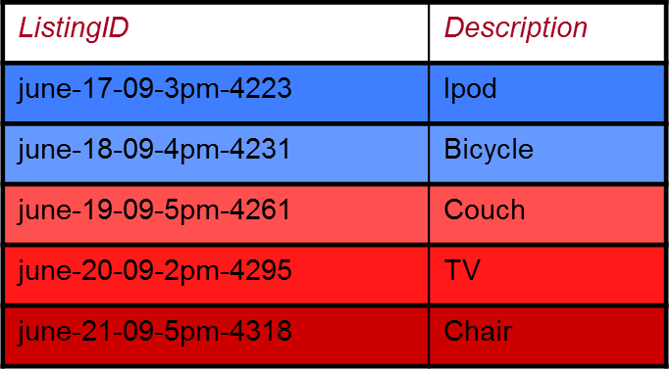
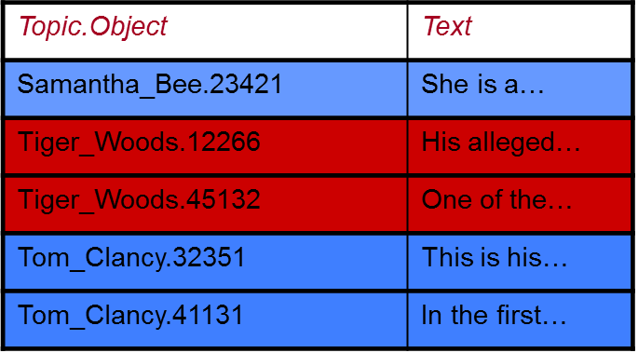
Ordered tables are tricky
Hotspots!
Solution: Proactive load balancing
Move tablets from hot servers to cold servers
If necessary, split hot tablets
Source:http://www.brianfrankcooper.net/

Slide 26
Tablet Splitting & Balancing
Each storage unit has many tablets (horizontal partitions of the table)
Storage unit may become a hotspot
Overfull tablets split
Tablets may grow over time
Shed load by moving tablets to other servers
Source:http://web.eecs.umich.edu/~michjc/eecs584/notes/lecture18-pnuts.pptx

Slide 27
Replication and Consistency
PNUTS Uses:
Asynchronous replication to ensure low latency updates.
Yahoo! Message broker , a publish/subscribe system developed at Yahoo both as replacement for redo log and as replication mechanism.

Slide 28
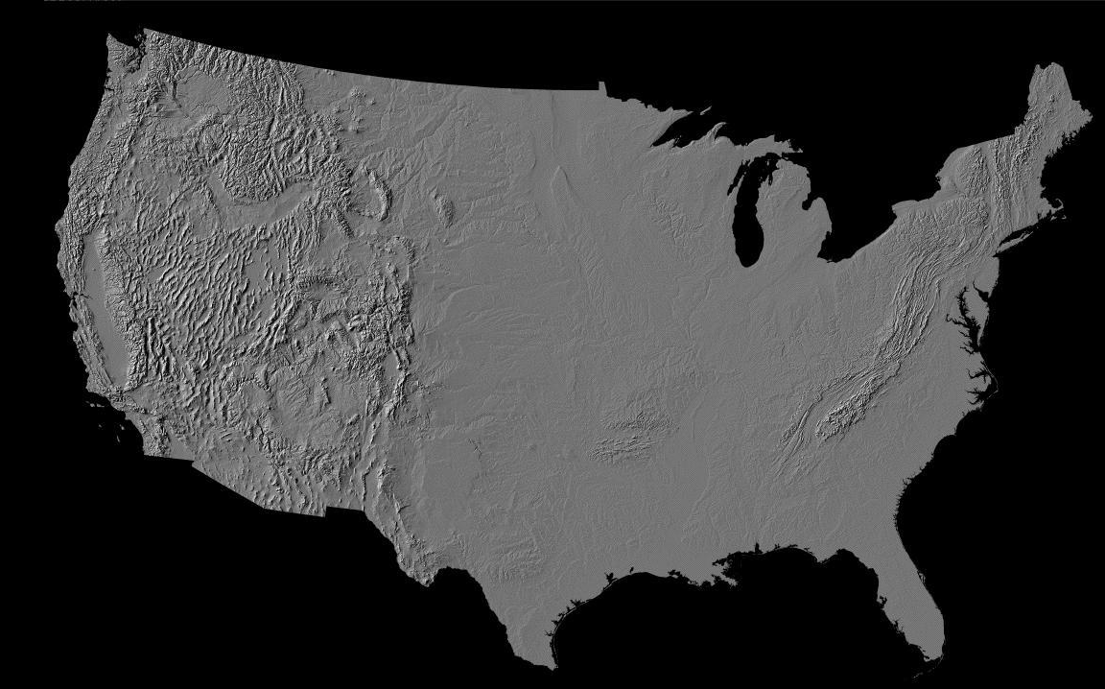
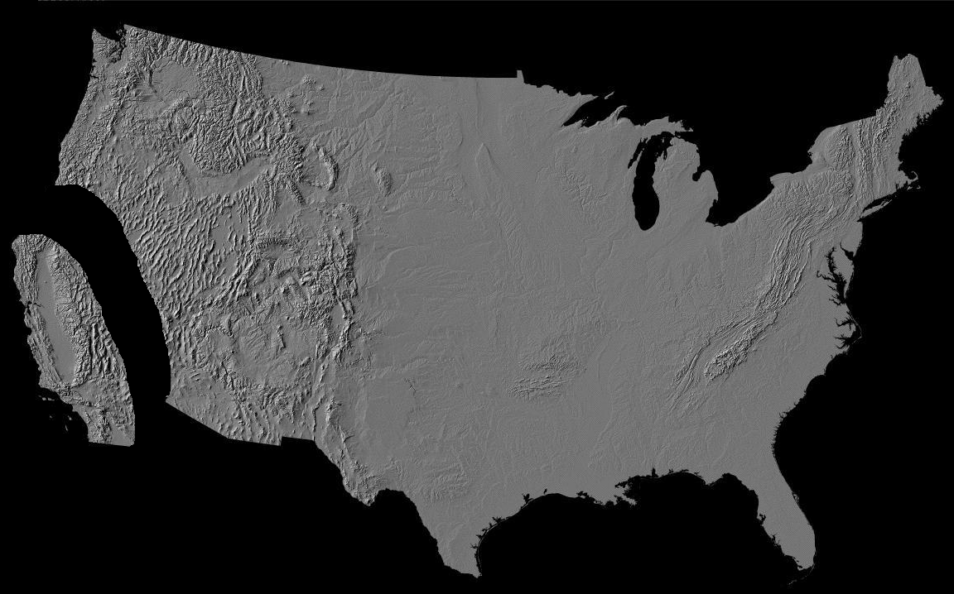


Asynchronous Replication
Source:http://www.cse.iitb.ac.in/infolab/Data/Courses/CS632/Talks/pnuts-vldb08.ppt

Slide 29
Yahoo! Message Broker (YMB)
Distributed publish-subscribe system
Guarantees committed once a message is published
Data updates asynchronously propagated to regions (subscribers) and applied to replicas
Record updates are published to YMB by master copy
All replicas subscribe to the updates, and get them in same order for a particular record

Slide 30
Why YMB?
YMB ensures messages are not lost before they applied to database.
YMB is designed for wide area application.
Different YMB clusters at different geographical regions communicate for record updates for serving subscribers
It eliminates individual PNUTS clusters from dealing with update propagation between regions.

Slide 31
Consistency
PNUTS designate one copy of record as master
All updates are directed to master
Since this is record-level mastering, two records in the same table can be mastered in different clusters.
Why record-level? Observerd 85% of writes originate from same datacenter. Tables, global. Records may be local.

Slide 32
Mastership
Hidden field in each record stores which copy is the master copy
updates can be submitted to any copy
forwarded to master, applied in order received by master
Record also contains origin of last few updates
Mastership can be changed by current master, based on this information
Mastership change is simply a record update
Tablets mastership
Required to ensure primary key consistency
Can be different from record mastership

Slide 33

Mastering
A 42342 E
A 42342 E
B 42521 E
B 42521 W
C 66354 W
C 66354 W
D 12352 E
D 12352 E
E 75656 C
E 75656 C
F 15677 E
F 15677 E
A 42342 E
A 42342 E
B 42521 W
B 42521 E
C 66354 W
C 66354 W
D 12352 E
D 12352 E
E 75656 C
E 75656 C
F 15677 E
F 15677 E
A 42342 E
B 42521 W
C 66354 W
D 12352 E
E 75656 C
F 15677 E
Source:http://www.cse.iitb.ac.in/infolab/Data/Courses/CS632/Talks/pnuts-vldb08.ppt
33

Slide 34
Record versus Tablet Master
Record master serializes updates
A 42342 E
A 42342 E
B 42521 E
B 42521 W
C 66354 W
C 66354 W
D 12352 E
D 12352 E
E 75656 C
E 75656 C
F 15677 E
F 15677 E
Tablet master serializes inserts
A 42342 E
A 42342 E
B 42521 W
B 42521 E
C 66354 W
C 66354 W
D 12352 E
D 12352 E
E 75656 C
E 75656 C
F 15677 E
F 15677 E
A 42342 E
B 42521 W
C 66354 W
D 12352 E
E 75656 C
F 15677 E
34
Source:http://www.cse.iitb.ac.in/infolab/Data/Courses/CS632/Talks/pnuts-vldb08.ppt

Slide 35

Record Timeline Consistency
Transactions:
Alice changes status from “Sleeping” to “Awake”
Alice changes location from “Home” to “Work”
(Alice, Home, Sleeping)
(Alice, Home, Awake)
(Alice, Work, Awake)
Region 1
Awake
Work
(Alice, Work, Awake)
Work
(Alice, Home, Sleeping)
(Alice, Work, Awake)
Region 2
No replica should see record as (Alice, Work, Sleeping)
Source: http://www.slideshare.net/smilekg1220/pnuts-12502407

Slide 36
Recovery
Recovery from failure involves copying lost tablets from another replica.
It involves three step process
Tablet controller request a copy from remote replica (source)
Publish “checkpoint message” to YMB to apply in-flight updates (to source)
Copy source tablet to destination region

Slide 37
Coping With Failures
X
X
A 42342 E
B 42521 W
C 66354 W
D 12352 E
E 75656 C
OVERRIDE W → E
F 15677 E
A 42342 E
B 42521 W
C 66354 W
D 12352 E
E 75656 C
F 15677 E
A 42342 E
B 42521 W
C 66354 W
D 12352 E
E 75656 C
F 15677 E
37
Source:http://www.cse.iitb.ac.in/infolab/Data/Courses/CS632/Talks/pnuts-vldb08.ppt

Slide 38
Recovery (Contd..)
Create “backup regions” near serving replicas.
Backup region maintain a back-up replica.
Recovering a table involve transferring it from backup region in the same or nearby datacenter.
Minimizes bandwidth cost and latency.

Slide 39
Query Processing
Single read or update done can be directly forwarded to SU
Multi-record request
Scatter-gather engine receives a multiple record request
Splits it into multiple individual requests for single record or tablet scans and initiates them in parallel
Assembles the results and sends to client.

Slide 40
Query Processing
Server side approach
Prevent multiple parallel client request
Server side optimization
Range Queries
Returns first set of results
Constructs and returns continuation object which retrieve next set of results

Slide 41
Notifications
Pnuts provides a service for notifying external systems of update to data
Provides mechanism to subscribe to all topics for a table
Isolate client from knowledge of tablet organization
Automatic subscription when new topic is created due to tablet split
Break subscriptions of slow notification clients
Discard their messages if backlog gets large

Slide 42
Hosted Database Services
Centrally-managed database service shared by multiple application
Increase capacity by adding servers
Automatically recover from failure by copying data(from replica)
Load balancing
Complications in hosted model
Support to different workload profiles
Performance isolation(assigning different applications to different SU within a region)

Slide 43
Applications
The Yahoo! Applications which motivated and influenced PNUTS:
User Database
Social Applications
Content Meta-Data
Listings Management
Session Data
Yahoo! applied PNUTS on some of these applications, while others are still under progress.

Slide 44
User Database
Yahoo!’s User Database has hundreds of millions of active users and billions of total users.
Each record contains profile information, application-specific data, usage statistics.
The volume of traffic is very high which is balanced using massive parallelism and the asynchrony model of PNUTS.
Relaxed consistency is accepted.

Slide 45
Social Applications
Social applications require a flexible data store supporting information sharing and connection between users.
PNUTS resolves this by the massive parallelism concept and the ordered table abstraction is used to represent connections in social graph.
Social applications have large number of writes and require a scalable system such as PNUTS.
Relaxed consistency is accepted.

Slide 46
Content Meta-Data
Yahoo! faces a challenge of storing massive data such as mail attachments, images and videos.
Although PNUTS is not optimized to provide mass storage, it stores the metadata of a distributed bulk storage system.
PNUTS ensures high performance for metadata operations such as file creation, deletion, renaming and moving between directories.

Slide 47
Listings Management
Comparison shopping sites such as Yahoo! Shopping aggregate listings of items from many sources.
The ordered table implementation in PNUTS provides us to store listings, sorted by timestamp.
This implementation provides us to create a view of the data using secondary attributes.

Slide 48
Session Data
Websites generally maintain per-session state, and in a large website like Yahoo! there are a large number of concurrent sessions active.
To store this data, which would be increasing with every new user, scalability is the main concern which is resolved by PNUTS.
Managing session data is very common across web applications and using PNUTS as a service provides applications to use the session store.

Slide 49
Experimental Results
Experimental Setup:
Three PNUTS regions
2 west coast, 1 east coast
5 storage units, 2 message brokers, 1 router
West: Dual 2.8 GHz Xeon, 4GB RAM, 6 disk RAID 5 array
East: Quad 2.13 GHz Xeon, 4GB RAM, 1 SATA disk
Workload
1200-3600 requests/second
0-50% writes
80% locality

Slide 50
Experimental Results
Experimental Data:
One region (West 1) is the tablet master
Hash: 99 clients (33 per region), MySQL: 60 clients
1 million records, 1/3 per region
Result:
Hash: West1: 75.6ms; West2: 131.5ms, East 315.5ms
Ordered: West1: 33ms; West2: 105.8ms, East 324.5ms
MySQL is faster than hash, although more vulnerable to contention

Slide 51
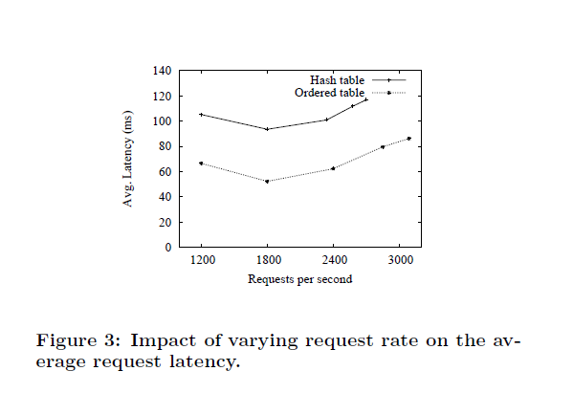
Experimental Results
Varying Load:
Requests vary between 1200 – 3600 requests/second with 10% writes

Slide 52
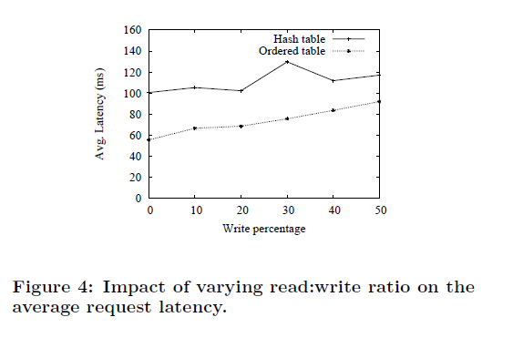
Experimental Results
Varying Read/Write Ratio:
Ratios vary between 0 and 50%
Fixed 1,200 requests/second

Slide 53
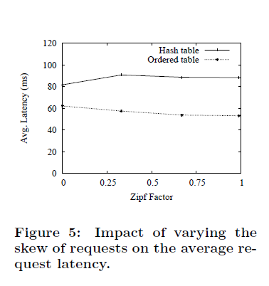
Experimental Results
Varying Skew:
Zipf parameter vary from 0 (uniform) to 1 (highly skewed)
1200 requests per second

Slide 54
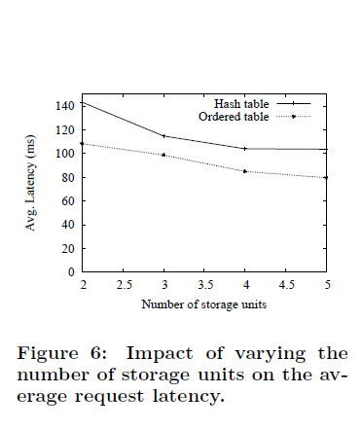
Experimental Results
Varying Number of Storage Units:
Storage units per region vary from 2-5
10% writes, 1,200 requests/seconds

Slide 55
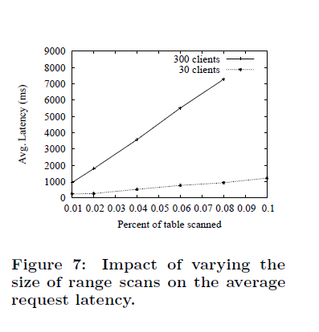
Experimental Results
Varying Size of Range Scans:
Range scan between 0.01 to 0.1% size
Ordered table only
30 clients vs. 300 clients

Slide 56
Ongoing work
Indexes and materialized views
Bundled updates
Batch query processing
Conclusion:
Rich database functionality and low latency at massive scale
Tradeoffs between functionality, performance and scalability
Choose asynchronous replication to ensure low write latency
Delivers the data management as hosted service

